Slide 1
Module 10
Positioning Decisions
By: Dr Shahinaz Abdellatif

Slide 2
Objectives of the Session
To understand:
1. positioning and why it is important
2. the differences between physical and perceptual product positioning
3. the steps involved in the positioning process
4. market positioning strategies

Slide 3
What do we mean by positioning?
  Creating distinct and valued physical and perceptual differences between one’s product and its competitors, as perceived by the target customer.
  Positioning (or repositioning) refers to both the place a product or brand occupies in customers’ minds relative to their needs and competing products or brands and to the marketer’s decision making intended to create such a position.
  Positioning notion comprises both competitive and customer need considerations.
Notes:
Critical words and why they matter
Distinct: Why would anyone choose it, if it’s not different than what they now buy?
Valued: Differences that are not valued won’t do much good.
Physical: The goods or services must “walk the talk” and be different; marketing “me-too” products is very difficult.
Perceptual: If the customer does not perceive the difference, the difference will not matter.
As perceived by/in the minds of: It’s what the customer perceives that counts, not what the marketer perceives.

Slide 4
Positioning
Positioning is the choice of:
Where we want to compete (Target Market)
How we wish to compete (Differential Advantage)
Objective of Positioning:
To create & maintain a distinctive place in the market for a company & its products.

Slide 5
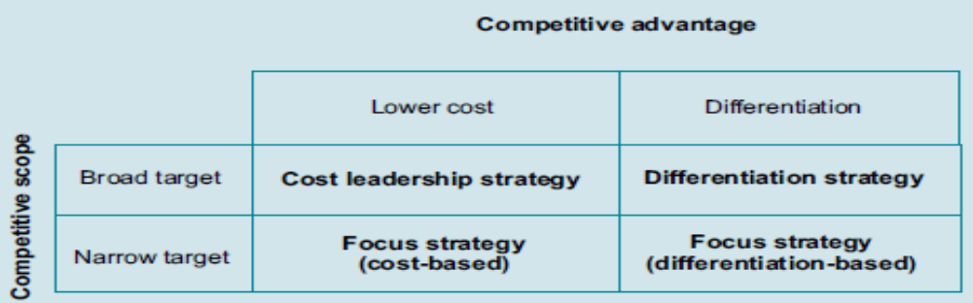
Generic competitive Strategies
  Differentiation lies at the heart of marketing (i.e. products that are superior on some important dimensions) represent distinctly different ways in which companies can compete for the minds and wallets of customers in their target markets.
Notes:
Critical words and why they matter
Distinct: Why would anyone choose it, if it’s not different than what they now buy?
Valued: Differences that are not valued won’t do much good.
Physical: The goods or services must “walk the talk” and be different; marketing “me-too” products is very difficult.
Perceptual: If the customer does not perceive the difference, the difference will not matter.
As perceived by/in the minds of: It’s what the customer perceives that counts, not what the marketer perceives.

Slide 6
Dimensions on which Consumers Perceive Competitive Offerings
Simple physically based attributes
e.g. price/quality/size/power
Complex physically based attributes (subjective)
Essentially abstract attributes
e.g. mystery of a perfume or prestige of a car

Slide 7
Comparisons of Physical and
Perceptual Positioning Analysis
Perceptual positioning
Another way is to assess the percieved benefits of the product what it does than what it is. Here evaluation of many products is subjective because it is influenced by factors other than physical properties, including the way products are presented, our
past experiences , opinions of others.
Consumer orientation
Perceptual attributes
Perceptual measures
Need for marketing research
Perceptual brand positions and positioning intensities
Limited number of dimensions
Represents impact of product specs and communication
R&D implications need to be interpreted
Physical positioning
One way to assess the current position of a product offering relative to competitors is on the basis of how the various offerings compare on some set of objective physical characteristics (ex: package, brand name, price, and ancillary services)
Technical orientation
Physical characteristics
Objective measures
Data readily available
Physical brand properties
Large number of dimensions
Represents impact of product specs and price
Direct R&D implications
Notes:
2

Slide 8
Positioning Process
1. Identify relevant set of competitive products.
2. Identify set of determinant attributes that define ‘product space’ in which positions of current offering are located.
3. Collect information from a sample of customers about
perceptions of each product on determinant attributes.
4. Analyse intensity of a products’ current position in
customers’ minds.
5. Determine products’ current location in product space
(product positioning).
6. Determine customers’ most preferred combination of
determinant attributes.
7. Examine fit between preferences of market segmentations and current position of product (market positioning).
8. Select positioning or repositioning strategy.

Slide 9
The Positioning Statement
A Positioning Statement for Volvo in North America
For upscale American families, Volvo is the family automobile that offers maximum safety
Generic format for positioning statements: For (target market), (brand) is the (product category) that (benefit offered).
Notes:
What are the key elements here?
Target market
Benefit: note how many (only one!)

Slide 10
Perceptual Map
A useful tool for doing so is the positioning grid, also called a perceptual map. The positioning grid provides a visual representation of the positions of various products or brand in the competitive set in terms of (typically) two determinant attributes.
Where more than two attributes are to be considered in a positioning analysis, multidimensional grids, or multiple grids, are produced.

Slide 11
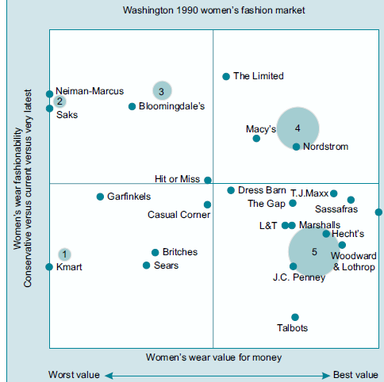
Perceptual Map

Slide 12
Value Proposition
A value proposition is similarly explicit about what the product does for the customer (and sometimes, what it does not do) and typically also includes information about pricing relative to competitors.
It is important that the positioning statement or value proposition states benefits that the user of the product will obtain, rather than features or attributes of the product itself,
Both positioning statements and value propositions should reflect a unique selling proposition that the product embodies.
In this sense, they reflect the basis on which the marketer intends to win sustainable competitive advantage by differentiating the product from others in its competitive space. In its shortest form, a value proposition typically include:
• Target market
• Benefits offered (and not offered)
• Price range (relative to competitors)

Slide 13
..or a Value Proposition
Value Proposition for Volvo in North America
Target market: Upscale American families
Benefits offered: Safety
Relative price: 20% premium to domestic family cars
Generic format for value propositions:
  Target market
  Benefits offered (and sometimes not offered)
  Relative price

Slide 14
Some Key Questions
Concerning Positioning Decisions
For whom are they written?
In what sort of language?
Should they focus on features or benefits?
How many differentiating attributes should anchor them?
Notes:
For whom are positioning statements or value propositions written?
An internal audience: marketing decision makers and ad agencies
Should they be written in catchy consumer language or “plain prose?”
Plain prose. The ad agency or other creative staff will develop the catchy consumer language, based on the chosen positioning. Can the class think of examples of catchy current tag lines and the positioning they represent?
Should they focus on features or benefits? Why?
Benefits, which are ultimately why people buy (e.g., safety, for Volvo, vs. side door airbags)
What’s a feature?
A physical attribute of the good or service itself
What’s a benefit?
The end-use consequences that the user will experience by using the product
On how many attributes should one’s positioning be based?
One, or perhaps two at most. No more. Why?
Clear and simple communication
No confusion about what the product stands for.
Examples?
Volvo: Safety. Note there’s more Volvo could say, but here’s where they focus. (One attribute)
Miller Lite beer: Tastes great. Less filling. (Two attributes)
Domino’s Pizza: Fast, hot delivery

